Slide 1

Structure of a Compiler
Compiler Design
Phase-wise Illustration
Example-based Explanation for B.Tech Students

Slide 2

Example Program (Input Source Code)
Main(){
int a;
a = 5 + 3;
}
Objective:
• Understand how a compiler processes this program
• Observe the transformation at each compilation phase

Slide 3
Overview of Compiler Phases
1. Lexical Analysis
2. Syntax Analysis
3. Semantic Analysis
4. Intermediate Code Generation
5. Code Optimization
6. Code Generation
7. Linking and Assembly
8. Error Handling

Slide 4

Lexical Analysis (Scanner)
Input:
int a;
a = 5 + 3;
Purpose:
• Convert source code into tokens
• Remove unnecessary characters like spaces and comments

Slide 5

Lexical Analysis – Output (Tokens)
int → KEYWORD
a → IDENTIFIER
; → SYMBOL
a → IDENTIFIER
= → OPERATOR
5 → NUMBER
+ → OPERATOR
3 → NUMBER
; → SYMBOL

Slide 6



Syntax Analysis (Parser)
Parse Tree
Tokens
Parser

Slide 7

Syntax Analysis – Parse Tree
=
/ \
a +
/ \
5 3
Example Syntax Error:
a = 5 + ;

Slide 8

Semantic Analysis
Checks:
Variable declared
Type compatibility
Valid operations

Slide 9

Semantic Analysis – Symbol Table
Variable: a
Type: int
Scope: local

Slide 10
Semantic Error Example
float a;
a = "Hello";
Explanation:
Type mismatch detected

Slide 11

Intermediate Code Generation
Purpose:
Output:
Intermediate Representation
Machine-independent code

Slide 12
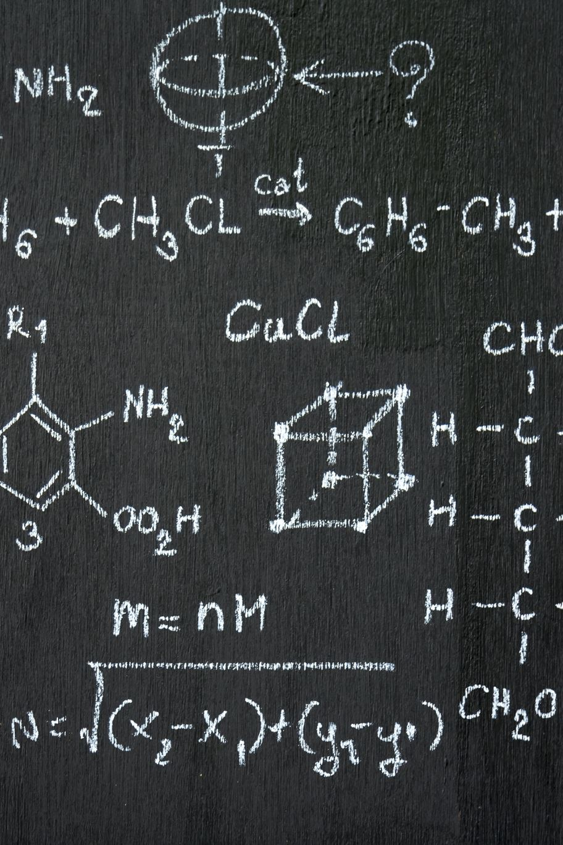
Intermediate Code (Three Address Code)
t1 = 5 + 3
a = t1

Slide 13
Code Optimization
Before Optimization:
t1 = 5 + 3
a = t1

Slide 14
Code Optimization – After Optimization
After Constant Folding:
a = 8

Slide 15
Code Generation
Purpose:
Convert optimized code to machine code

Slide 16
Code Generation – Example
MOV R1, #8
MOV a, R1

Slide 17
Linking and Assembly
• Combine libraries
• Generate executable
Output:
a.out / program.exe

Slide 18
Error Handling
Lexical: @a = 5;
Syntax: a = + 5;
Semantic: int a; a = 3.5;

Slide 19
One-Line Compilation Flow
Source Code → Tokens → Parse Tree → Semantic Check → IR → Optimized Code → Machine Code → Executable

Slide 20
Conclusion
• Compiler works in phases
• Each phase transforms code
• Efficient executable is generated

Slide 21

Thank You
Questions & Discussion

